Slide 1
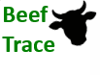
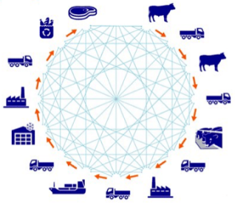
Do you really want to know what’s in your burger?
Golden state foods
&
IBM
Presented by
Neha Vipperla
Aishani Sood
Grant LeMaster

Slide 2
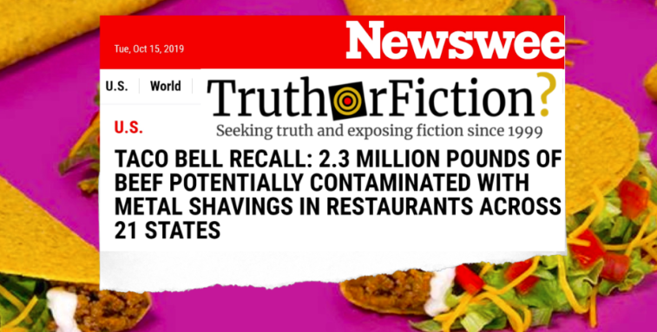
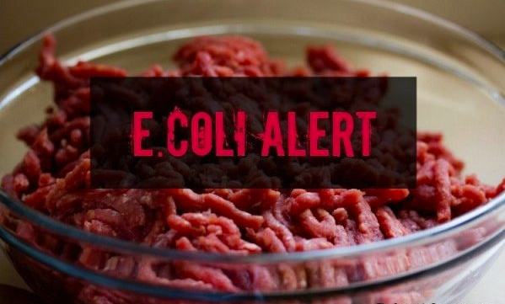
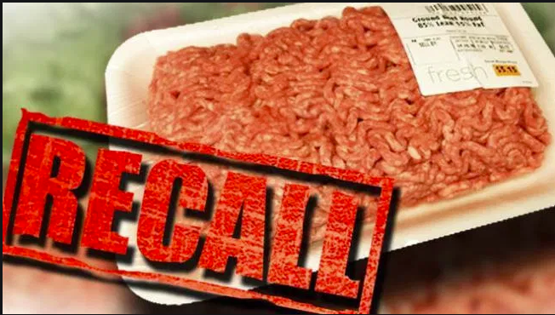
Beef Recalls
2018’s record breaking number of beef recalls
31 instances
13 million pound
So far in 2019
28 recalls and some still active
3 million pounds
A food recall cost on average $10 million
Does not include legal costs, fines, or penalties
Potential reputation damage and loss of future sales
Notes:
https://www.huffpost.com/entry/ground-beef-recalls-food-poisoning_l_5dc980e6e4b00927b2371a9a

Slide 3
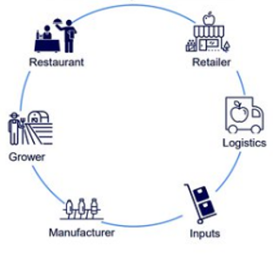
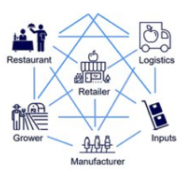


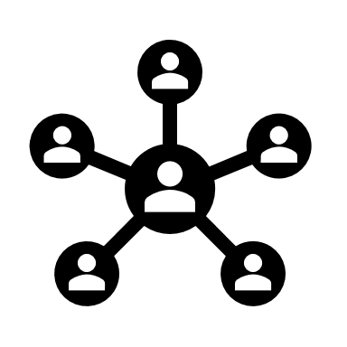
Current challenges
Today’s Challenges
Tomorrow’s Solution
Server
Server
Server
Blockchain
Notes:
The beef supply chain, in particular, is highly segmented and only growing in complexity. Before a hamburger lands on a customer’s plate, at least half a dozen businesses— ranches, feedlots, packers, processors, distribution centers, and restaurants— have had a hand in its creation and transportation. Each business along that product lifecycle keeps its own meticulous records. Software systems designed to connect them, however, typically require a lot of manual inputs, are prone to errors, and encounter inherent delays. And those systems are not designed to track one of the most essential elements in the beef’s journey—the temperature at which it’s kept.
End to end traceability of meat products to allow the sources of contaminated to be accurately identified, limiting the scale of a food recall. monitoring and tracking
Food wastage, Huge sums of money spent on re call activities, No possible way to find the source or participant in the supply chain that caused the damage.
http://www3.weforum.org/docs/WEF_Traceability_in_food_value_chains_Digital.pdf
Above: The top row of blocks represent web interfaces and applications, the bottom layer(s) are data handling and storage. Today your data is stored in a silo. With blockchains your data will be stored (publically or pseudo anonymously) in a shared database. This diagram is adapted from a diagram by Nick Grossman, GM at Union Square ventures, however his also includes time.
https://www.provenance.org/whitepaper
Blockchain applications are effective at linking multiple parties that may not have identical incentives to sharing information
End to end traceability of beef will allow the sources of contaminated to be accurately identified, limiting the scale of a food recall
The system uses IOT devices, Advanced analytics, RFIDs, GPS tracking, QR codes, and mobile user interfaces
Individual participants can hide information that certain members of the network do not need to see
Promote trust between members of the supply chain

Slide 4
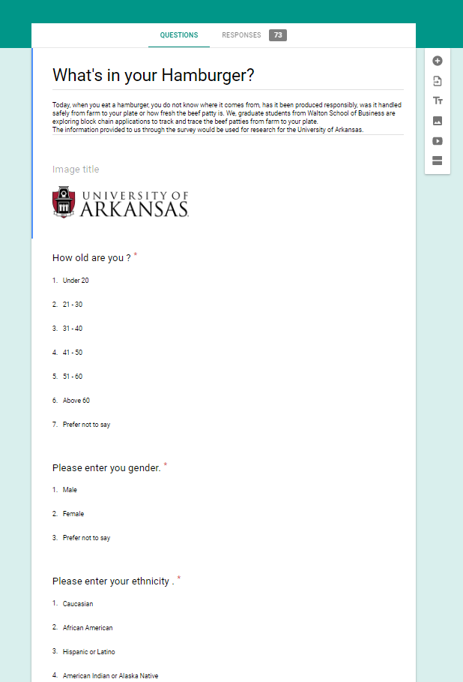
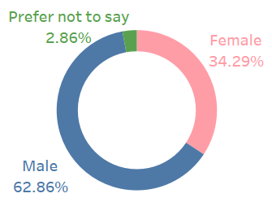
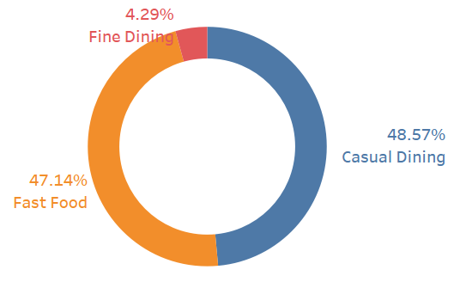
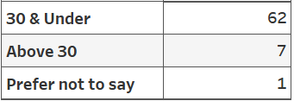
Survey
70
70

Slide 5
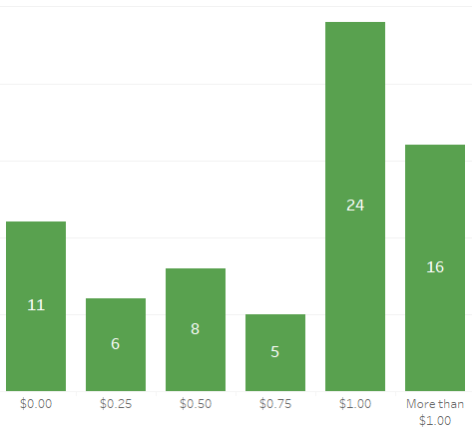
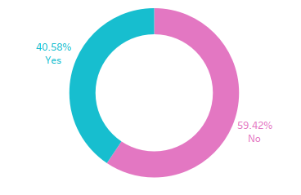
How much extra would you pay for the smart information about your burger?
Would you use a mobile app to know the smart details ?
Notes:
How much extra are you willing to pay for burger? if you could know,
where was the cow raised?
What was the cow fed? What antibiotics were administered?
When was the beef patty made?

Slide 6
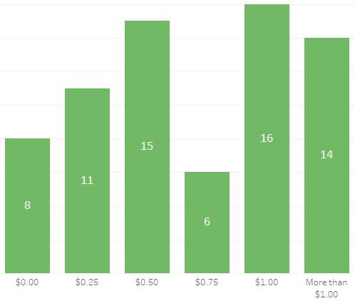
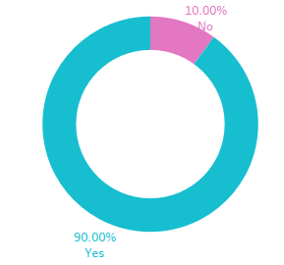
Would you prefer to eat beef from a local farm?
How much would you pay to support your local farmer ?
Notes:
Here we asked if the respondents would like to eat beef from a local farm and would they how much are they willing to tip the local farmers. We found that 90% would like to have beef that comes from a local farm. We also found that 45 % of the respondents are would pay a dollar or more.

Slide 7
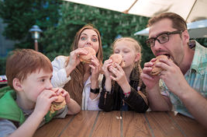
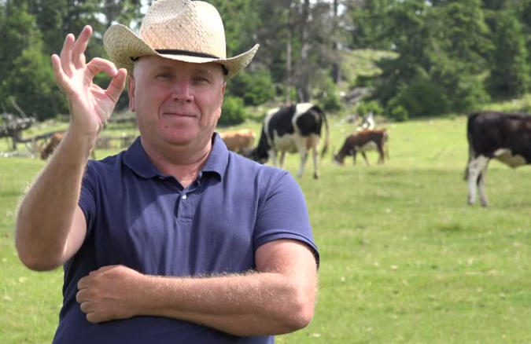
Our Vision
Empower our customers with information and instill them with the confidence to make safer choices while buying beef.
Our Mission
To build a solution that would increase transparency, accountability, traceability and add value to all participants in the blockchain network
Notes:
https://www.canstockphoto.com/young-man-and-woman-eating-fast-food-40266459.html

Slide 8

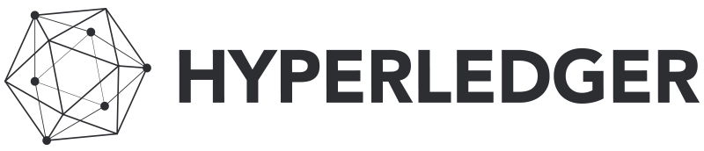
Blockchain Framework
Monitor, track, and trace
.
Chain of blocks
BFT
Cattlecoin
View permissions
Tipping Contracts
Notes:
https://www.techrepublic.com/article/how-to-install-hyperledger-fabric-on-ubuntu/
https://www.industryweek.com/technology-and-iiot/blockchain-explained

Slide 9

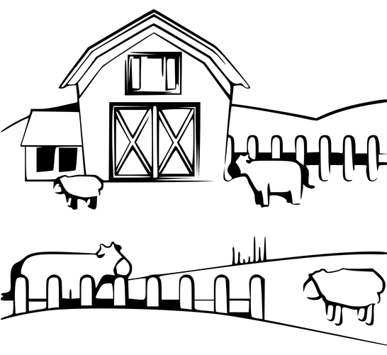
Beef Trace Overview
1. Farmers
2. Producer
4. Restaurants
5. Consumers
3. Logistics
Obligations:
RFIDs
Phone app
Data Entered:
Cow ID
Farm ID
Farm location
Breed
Notes:
http://images.clipartpanda.com/cattle-clipart-Cow-clip-art-cow-clipart-links-cow-images-clipart-2.png
https://www.jing.fm/iclipt/u2q8e6w7a9w7i1r5/

Slide 10

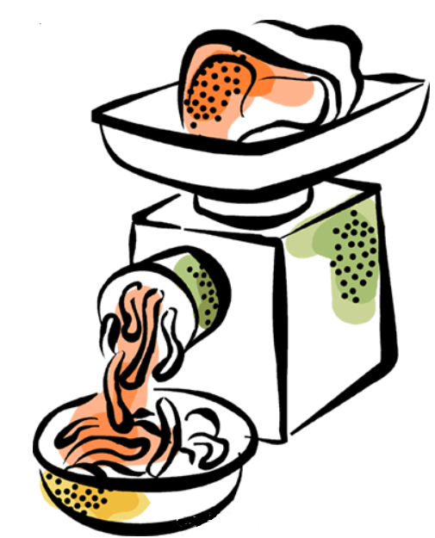
Beef Trace Overview
1. Farmers
2. Producer
4. Restaurants
5. Consumers
3. Logistics
Obligations:
Organize cows into lots
Print QR codes
USDA inspections
Data Entered:
Lot ID
Producer ID/Producer Name
Inspection Pass/Fail
Notes:
http://images.clipartpanda.com/cattle-clipart-Cow-clip-art-cow-clipart-links-cow-images-clipart-2.png
https://www.jing.fm/iclipt/u2q8e6w7a9w7i1r5/

Slide 11

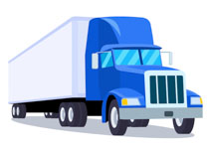
Beef Trace Overview
1. Farmers
2. Producer
4. Restaurants
5. Consumers
3. Logistics
Obligations:
Install IoT sensors
Data Entered:
Shipment ID
Temperature range
Geolocation
Time on Road
Notes:
http://images.clipartpanda.com/cattle-clipart-Cow-clip-art-cow-clipart-links-cow-images-clipart-2.png
https://www.jing.fm/iclipt/u2q8e6w7a9w7i1r5/

Slide 12
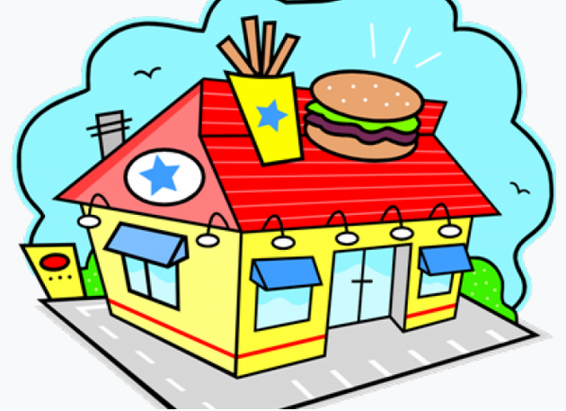
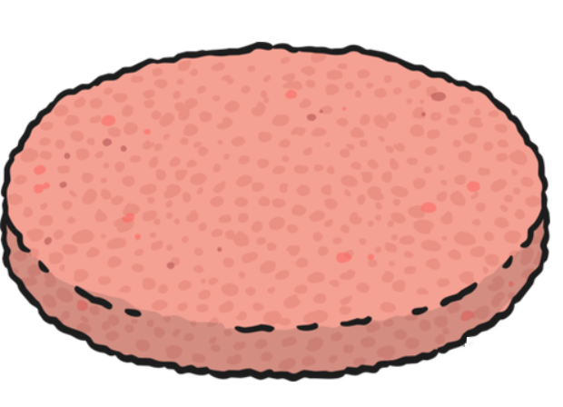
Beef Trace Overview
1. Farmers
2. Producer
4. Restaurants
5. Consumers
3. Logistics
Obligations:
Scan QR codes as consumed
Inform customers
IoT fridge
Data Entered:
Package ID
Restaurant ID
Active (Y/N)
Fridge Temperature
Notes:
http://images.clipartpanda.com/cattle-clipart-Cow-clip-art-cow-clipart-links-cow-images-clipart-2.png
https://www.jing.fm/iclipt/u2q8e6w7a9w7i1r5/

Slide 13
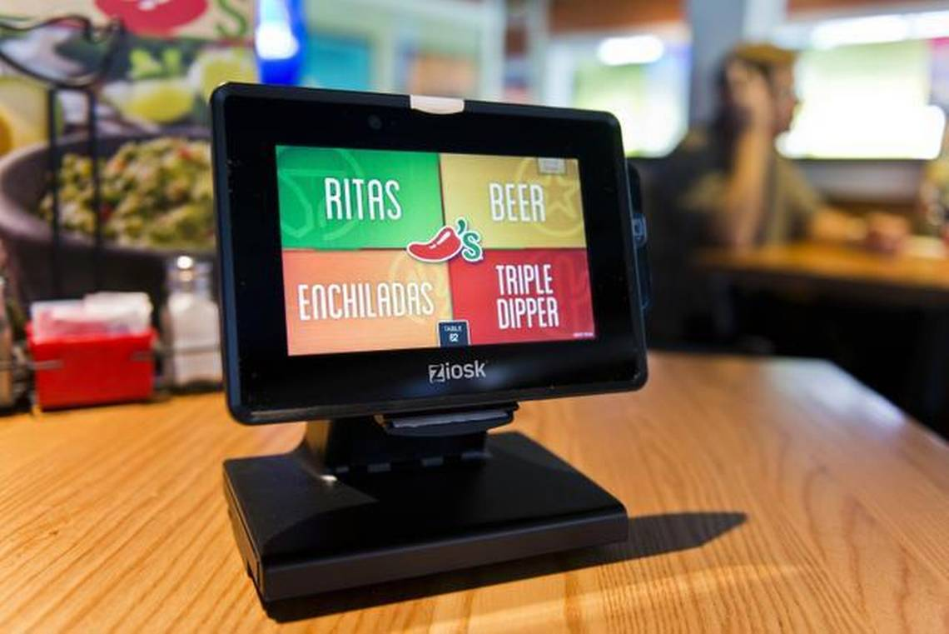

Beef Trace Overview
1. Farmers
2. Producer
4. Restaurants
5. Consumers
3. Logistics
Obligations:
Use table-side computers
View data before ordering
Tip farmers during payment
Notes:
http://images.clipartpanda.com/cattle-clipart-Cow-clip-art-cow-clipart-links-cow-images-clipart-2.png
https://www.jing.fm/iclipt/u2q8e6w7a9w7i1r5/

Slide 14


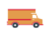



Cow ID
Farm ID
LOT ID
Producer ID/Name
Inspection
(Pass/Fail)
Janice
Location
Customer
Breed
Shipment ID
Temperature range
Geo Location
Time on road
Package ID
Restaurant ID
Active(Y/N)
Temperature
John
Cow ID
LOT ID
Producer ID/Name
Inspection
(Pass/Fail)
Farm ID
Location
Breed

Slide 15
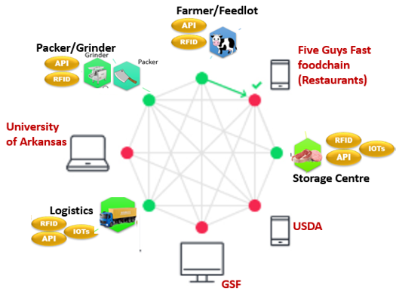
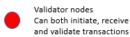

Viable
Ecosystem

Slide 16

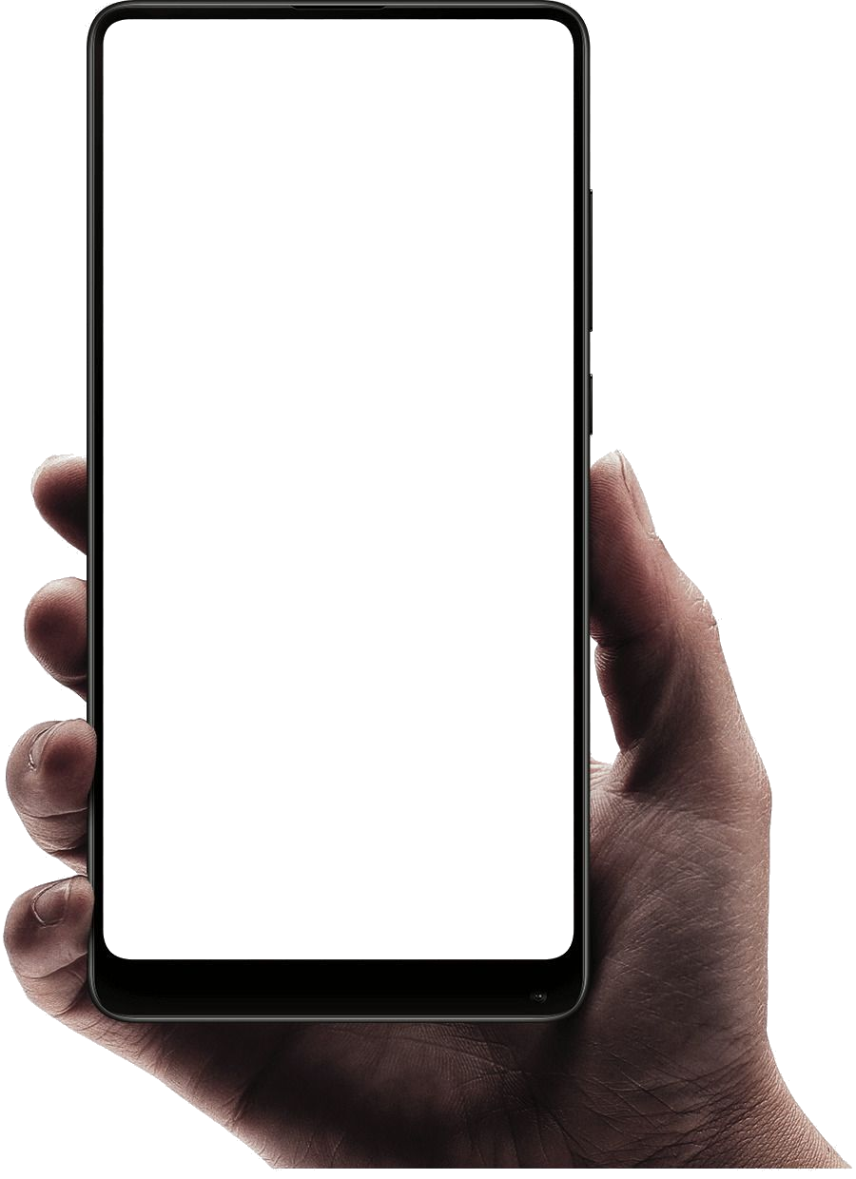









Mock View for User Interface
Beef
Trace
Farmer Mobile Application
Beef
Trace
Farm ID
Location
Packers
Grinders
Subscribe
Tips
Put on Blockchain
TIP Farmer
Restaurant Table Side Device

Slide 17


Users
Track
Monitor
Trace
Analyze
Permissioned
Chain of blocks
Cattle coin
BFT
Smart Contracts

Slide 18


